Slide 1

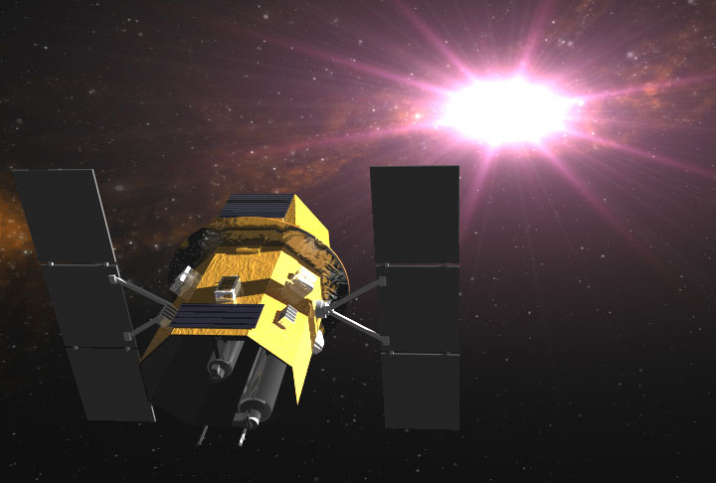
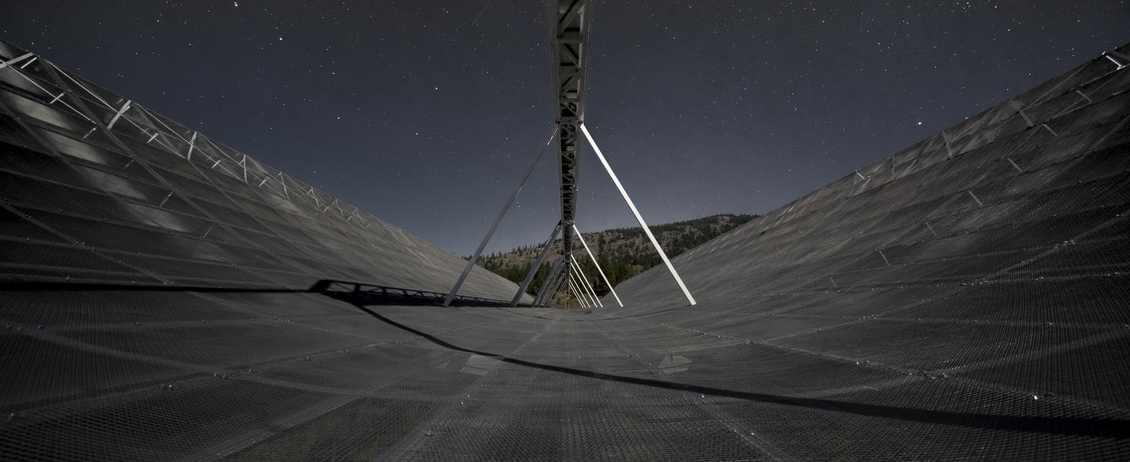
Hunting for γ-rays from Fast Radio Bursts (FRBs) using Swift/BAT & GUANO ​
​
By: Maxwell A. Fine​​
Advised by: ​Dr. Ziggy Pleunis, Dr. Paul Scholz, ​
Prof. Bryan Gaensler ​​
CHIME & SWIFT Image Credit: NASA & Chime collaboration​
Slide Background Image credit badrusblue​
​
Image Credit: Chime collaboration ​ & NASA ​
Image Credit: Chime collaboration ​ & NASA ​

Slide 2
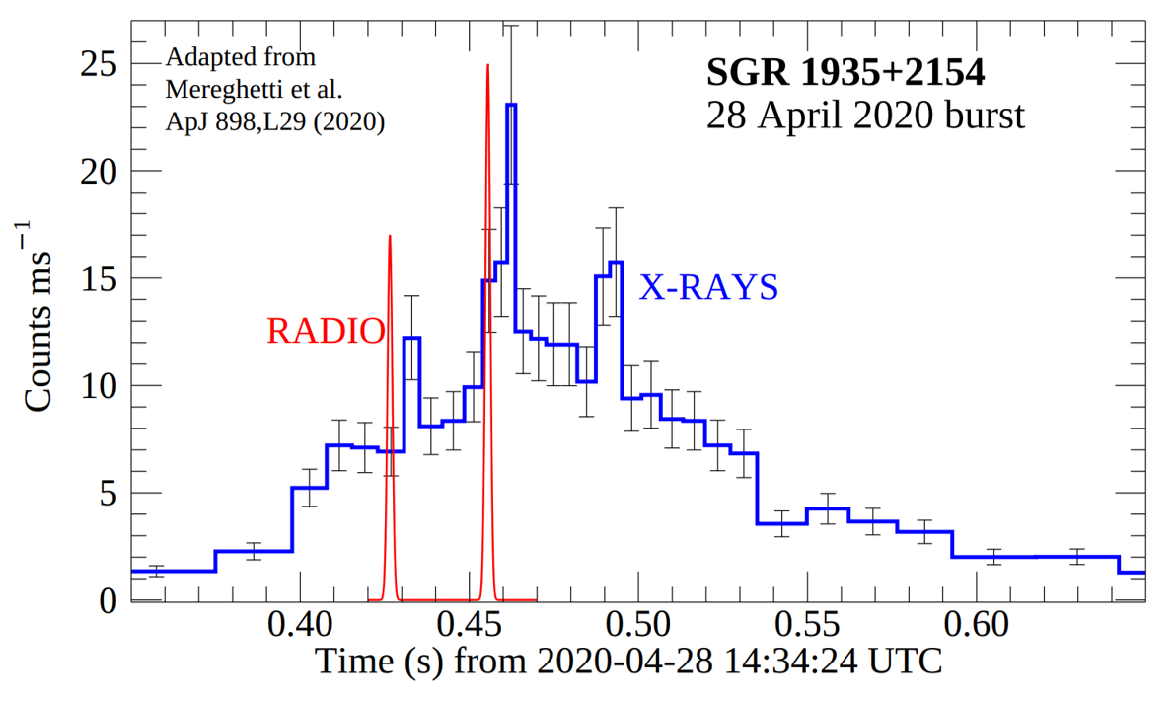
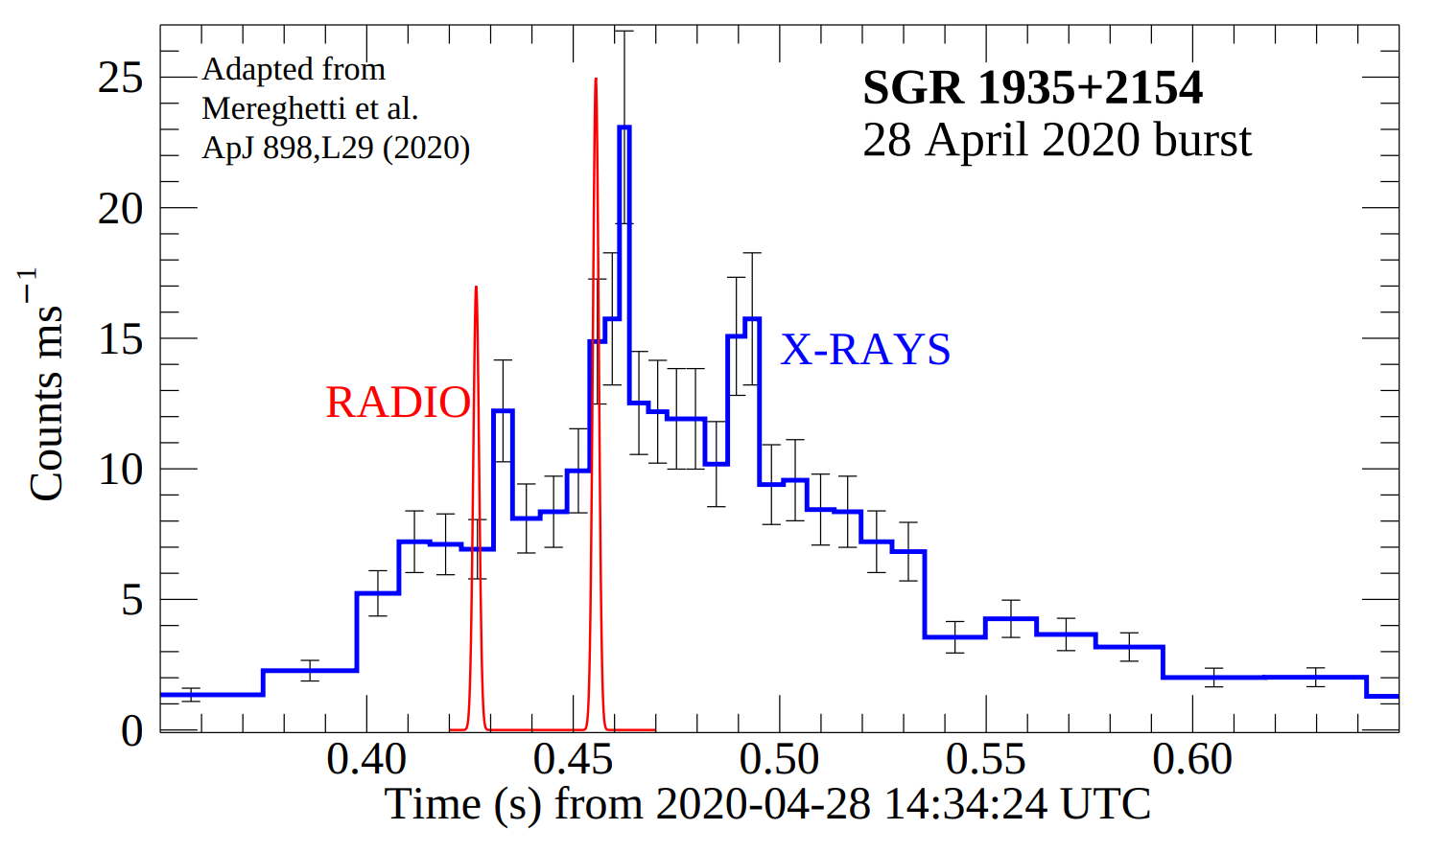
Fast Radio Bursts (FRBs):
Transient radio emission of unknown extra-galactic origin, there are more than 600 CHIME reported FRBs
Timescale of burst in radio wavelengths is ~1ms to 1s
Most FRB progenitor models involve magnetars, and predict associated
γ-ray emission
So far, FRBs have only been detected at radio wavelengths
=
Source: Petroff E., Hessels J. W. T., Lorimer D. R., 2022, Astron. Astrophys. Rev., 30, 2
E. Petroff et al 2022
Animation of random fast radio bursts in the sky. Credit: T. Jarrett (IPAC/Caltech); B. Saxton, NRAO/AUI/NSF.
Animation of random fast radio bursts in the sky. Credit: T. Jarrett (IPAC/Caltech); B. Saxton, NRAO/AUI/NSF.
Source: Petroff E., Hessels J. W. T., Lorimer D. R., 2022, Astron. Astrophys. Rev., 30, 2
Source: Petroff E., Hessels J. W. T., Lorimer D. R., 2022, Astron. Astrophys. Rev., 30, 2

Slide 3
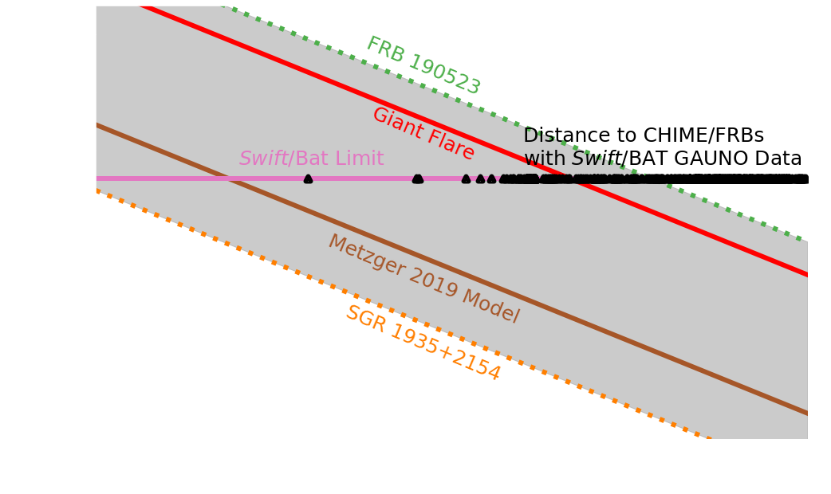
Project Motivation:
Previous γ-ray searches looked at a single repeating FRB, and
established fluence limits of
Thanks to GUANO, there is corresponding Swift/BAT data for more than 500 FRBs
No one has yet searched these CHIME/FRBS with Swift/BAT data
Project: systematic survey to establish fluence limits from FRBs
Swift/BAT Prospects
~ 10⁻⁷ erg/cm²
Source: Nicastro L., Guidorzi C., Palazzi E., Zampieri L., Turatto M., Gardini A., 2021, Universe, 7, 76
E. Petroff et al 2022

Slide 4
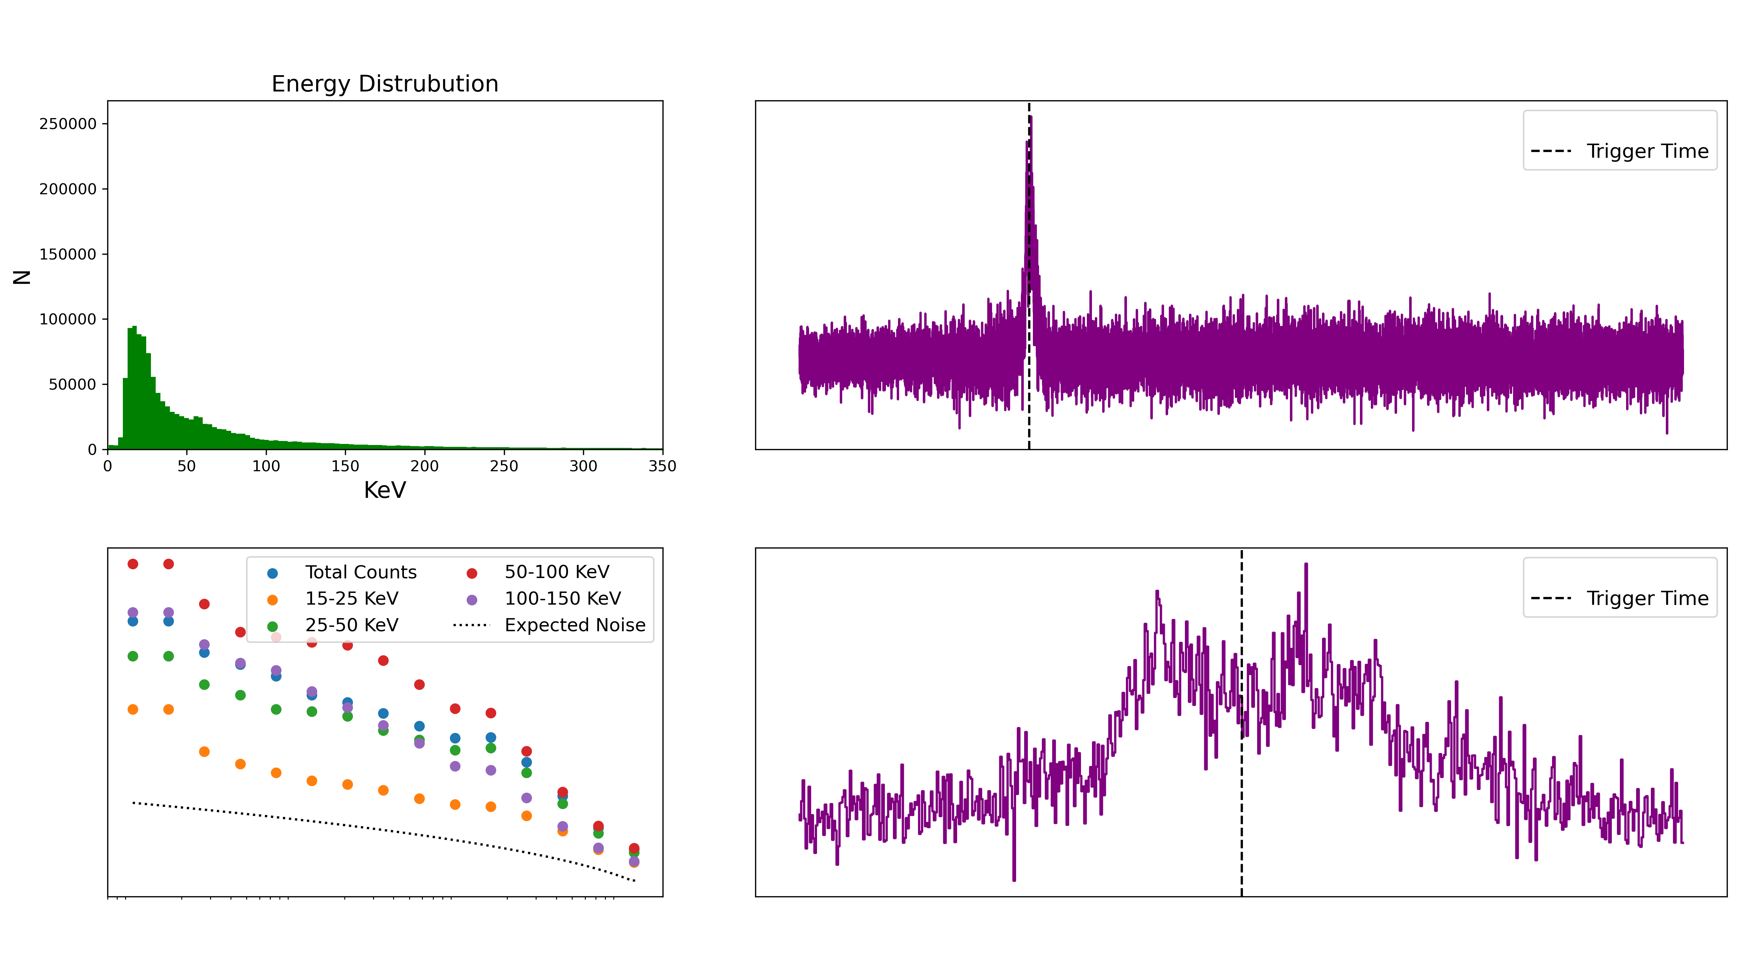
GRB: 20022A
​
​
​ ​
​
Lightcurve Analysis:
Swift/BAT light curves are more sensitive than Swift/BAT images
Searches the lightcurve in signal to noise (SNR) for a peak using a boxcar convolution with the size of the boxcar adjusted to search for different timescales
Boxcar search is looking around a window ± 3s centered on the CHIME detection time
SWIFT ID: 03110079007​
Time Resolution: 0.01s
Time Resolution: 0.01s
=
E. Petroff et al 2022
Animation of random fast radio bursts in the sky. Credit: T. Jarrett (IPAC/Caltech); B. Saxton, NRAO/AUI/NSF.
Animation of random fast radio bursts in the sky. Credit: T. Jarrett (IPAC/Caltech); B. Saxton, NRAO/AUI/NSF.
Source: Petroff E., Hessels J. W. T., Lorimer D. R., 2022, Astron. Astrophys. Rev., 30, 2
Source: Petroff E., Hessels J. W. T., Lorimer D. R., 2022, Astron. Astrophys. Rev., 30, 2

Slide 5

GRB: 20022A
​
​
​ ​
​
Lightcurve Analysis:
Swift/BAT light curves are more sensitive than Swift/BAT images
Searches the lightcurve in signal to noise (SNR) for a peak using a boxcar convolution with the size of the boxcar adjusted to search for different timescales
Boxcar search is looking around a window ± 3s centered on the CHIME detection time
SWIFT ID: 03110079007​
=
E. Petroff et al 2022
Animation of random fast radio bursts in the sky. Credit: T. Jarrett (IPAC/Caltech); B. Saxton, NRAO/AUI/NSF.
Animation of random fast radio bursts in the sky. Credit: T. Jarrett (IPAC/Caltech); B. Saxton, NRAO/AUI/NSF.
Source: Petroff E., Hessels J. W. T., Lorimer D. R., 2022, Astron. Astrophys. Rev., 30, 2
Source: Petroff E., Hessels J. W. T., Lorimer D. R., 2022, Astron. Astrophys. Rev., 30, 2

Slide 6
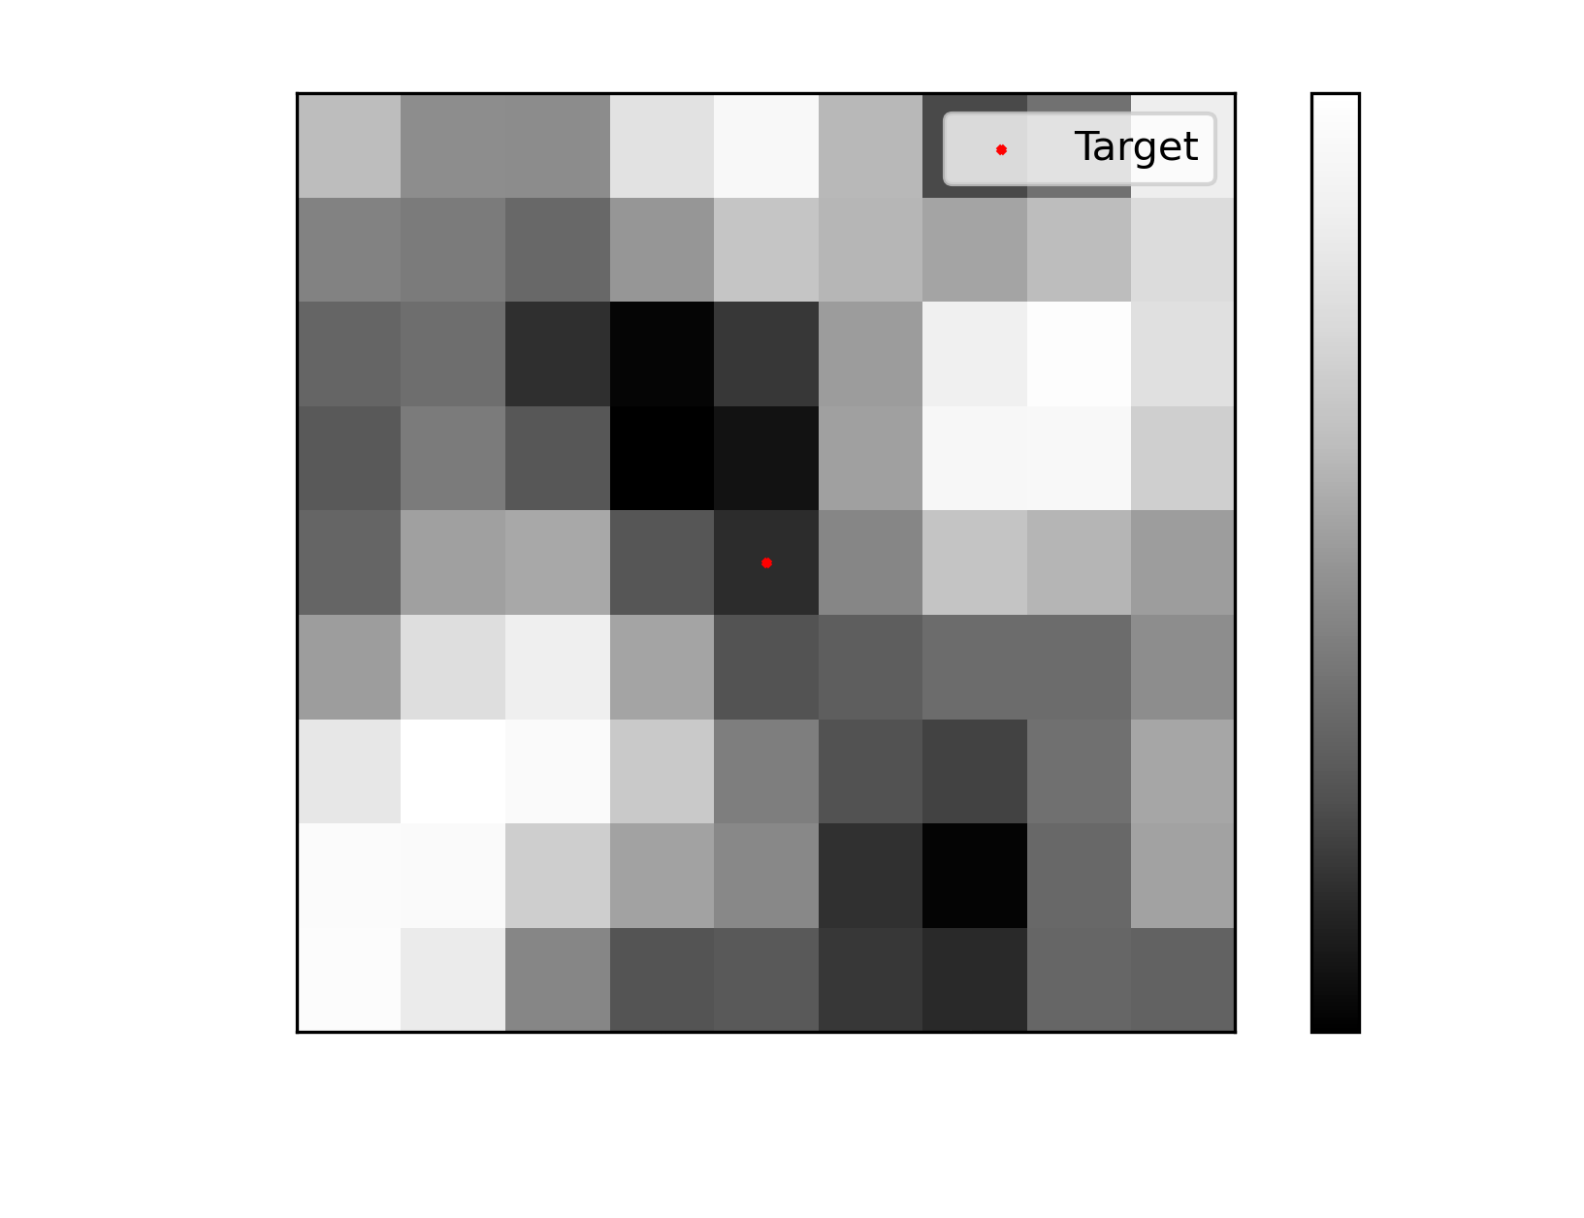
Sky Image Analysis:
Fluence limits require an estimated Poisson count limit, a Spectral Response File (RSP) file, and model spectra
The RSP file provides information about the effective area of the telescope for a specific sky position as a function of photon energy
Swift/BAT RSP files are generated for sky images, not lightcurves
Swift/BAT Sky Images look at ~1/8 the sky
Sky images are made with 6s exposures centered on the CHIME detection time
SWIFT ID: 03103240001
CHIME ID: ​199583879
=
E. Petroff et al 2022
Animation of random fast radio bursts in the sky. Credit: T. Jarrett (IPAC/Caltech); B. Saxton, NRAO/AUI/NSF.
Animation of random fast radio bursts in the sky. Credit: T. Jarrett (IPAC/Caltech); B. Saxton, NRAO/AUI/NSF.
Source: Petroff E., Hessels J. W. T., Lorimer D. R., 2022, Astron. Astrophys. Rev., 30, 2
Source: Petroff E., Hessels J. W. T., Lorimer D. R., 2022, Astron. Astrophys. Rev., 30, 2

Slide 7
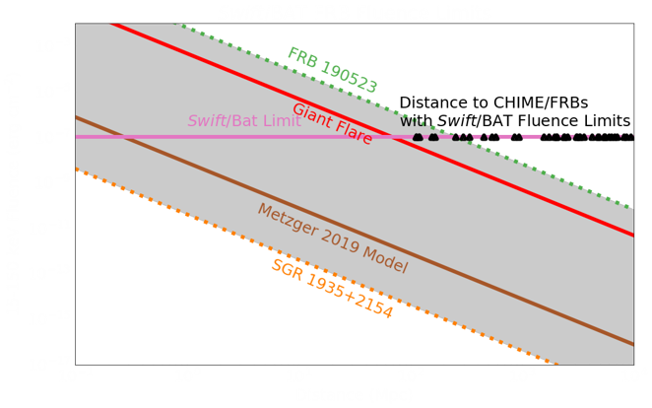
Results:
Searched a catalog of 380 FRBs sources
SNR estimates for 246 FRBs, No detections
Established fluence limits for 49 FRBs at ~ 10⁻⁷ erg/cm² in the 15-150 KeV band.
E. Petroff et al 2022

